Slide 1
Objectives
The objectives of this tutorial are to:
introduce some basic constructs in Verilog
elaborate on structural and behavioral design styles
introduce testbenches
enable you to design the ALU in your labs.

Slide 2
Ways of specifying circuits
Schematics
  Structural description
  Describe circuit as interconnected elements
    Build complex circuits using hierarchy
      Large circuits are unreadable
Hardware description languages (HDLs)
  Not programming languages
    Parallel languages tailored to digital design
  Synthesize code to produce a circuit

Slide 3
Data types that do NOT exist
Structures
Pointers
Objects
Recursive types
Verilog is not C or Java or Lisp or …!

Slide 4
Verilog versus VHDL
Both “IEEE standard” languages
Most tools support both
Verilog is “simpler”
  Less syntax, fewer constructs
VHDL is more structured
  Can be better for large, complex systems
  Better modularization

Slide 5
Verilog HDL
“The designers of Verilog wanted a language with syntax similar to the C programming language so that it would be familiar to engineers and readily accepted”
– Article on Verilog, Wikipedia
However, since Verilog is used to describe hardware, its behavior is different from that of the C language.

Slide 6
Verilog Language Organization
Concurrent Statements – executed in parallel
  Modules (similar to functions in C)
  Concurrent Assignment Statements
  Primitives
Sequential Statements – executed linearly
  Behavioral statements – if-then, for-loop
Data types – used to model hardware simple entities like ports, wires, registers, etc.

Slide 7

Basic Design Methodology
Requirements
RTL Model
Simulate
Synthesize
Gate-level
Model
Simulate
Test Bench
ASIC or FPGA
Place & Route
Timing
Model
Simulate

Slide 8
Two Main Data Types
Nets represent connections between things
  Do not hold their value
  Take their value from a driver such as a gate or other module
  Cannot be assigned in an initial or always block
Regs represent data storage
  Behave exactly like memory in a computer
  Hold their value until explicitly assigned in an initial or always block
  Can be used to model latches, flip-flops, etc.

Slide 9
Modules
Basic structure of a Verilog module:
module mymod(output1, output2, … input1, input2);
output output1;
output [3:0] output2;
input input1;
input [2:0] input2;
… endmodule
Verilog convention lists outputs first

Slide 10
Gate-level Primitives
Verilog provides the following:
and nand :logical AND/NAND
or nor :logical OR/NOR
xor xnor :logical XOR/XNOR
not :inverter

Slide 11
Inverter Example (Dataflow Style)
// module definition for the inverter
module inv (inp, op);
// port definitions
input inp; // input port “inp”
output op; // input port “op”
// concurrent assignment statement
assign op = ~inp; // ‘~’ is the unary “not” operator
// indicates the end of a module
endmodule

Slide 12
Inverter using primitives (Structural Style)
module inv (inp, op);
input inp;
output op;
// primitive statement
// similar to module instantiation (illustrated later)
// other primitives are – and, or, etc.
not (op, inp);
endmodule

Slide 13
Numbers
Format: <sign><size><base><number>
14
  Decimal number
12’b0000_0100_0110
  12 bit binary number (_ is ignored)
12’h046
  3-digit (12-bit) hexadecimal number

Slide 14
Multiplexer Example
// module definition
module mux2_1_bo(mux_in, sel, mux_out);
// port definitions
output mux_out;
input sel;
input [1:0] mux_in;
// concurrent assignment statement (~, &, | are invertor, AND, OR)
assign mux_out = (~sel & mux_in[0]) | (sel & mux_in[1]);
endmodule

Slide 15
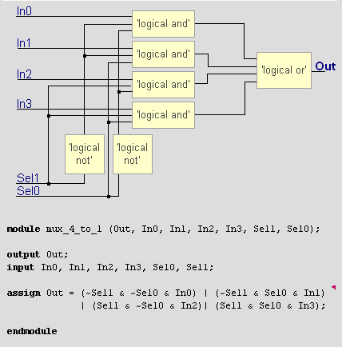
4to1 MUX: Dataflow style: Verilog Code
AND
NOT
OR

Slide 16
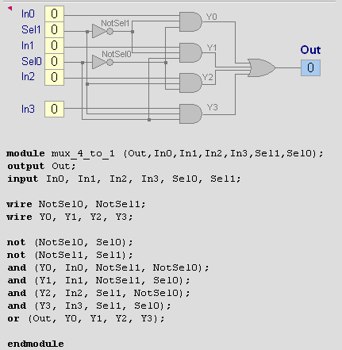
4to1 MUX: Structural style: Verilog Code
Wire: Intermediate node
Output first, inputs last for arguments

Slide 17
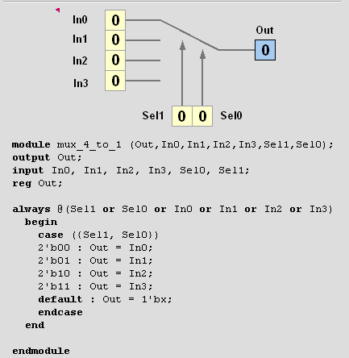
4to1 MUX: Behavioral style: Verilog Code
Note:
2’b11 means
a two-bit
binary with
value 11
Look at reg for output, we always have reg for the leftside variables of “always” block

Slide 18
Design Styles – Structural vs. Behavioral
Structural design style
  the structure of the design is described based on the structural information of its building blocks
Behavioral design style
  functionality of the behavior of the design is described algorithmically

Slide 19
Restrictions on Data Types
Data Flow and Structural Modeling
  Can use only wire data type
  Cannot use reg data type
Behavioral Modeling
  Can use only reg data type (within initial and always constructs)
  Cannot use wire data type

Slide 20
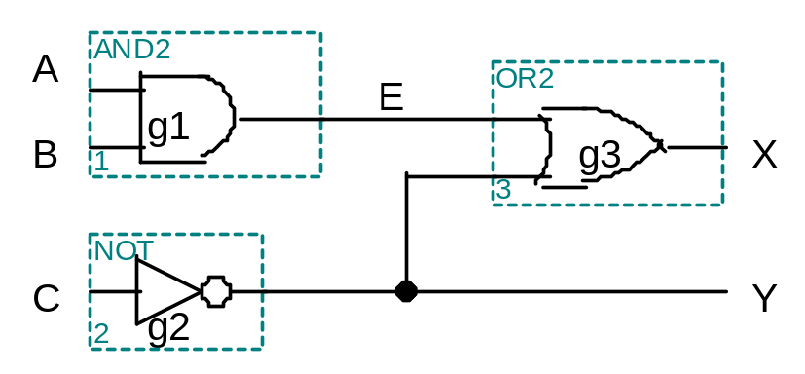
Specifying circuits in Verilog
Three major styles
  Instances and wires
  Continuous assignments
  “always” blocks
“Structural”
“Data Flow”
“Behavioral”
wire E;
and g1(E,A,B);
not g2(Y,C);
or g3(X,E,Y);
wire E;
assign E = A & B;
assign Y = ~C;
assign X = E | Y;
reg E, X, Y;
always @ (A or B or C)
begin
E = A & B;
Y = ~C;
X = E | Y;
end

Slide 21
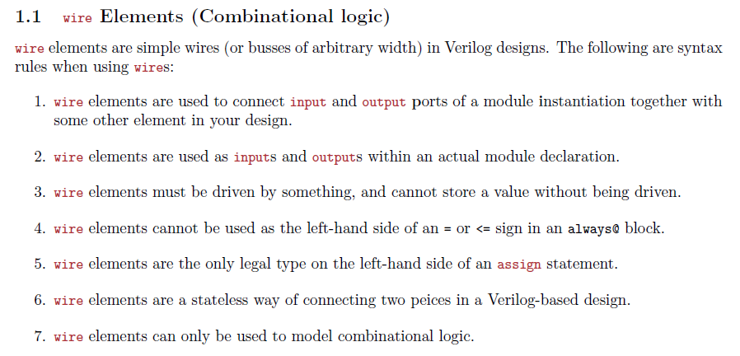

Slide 22
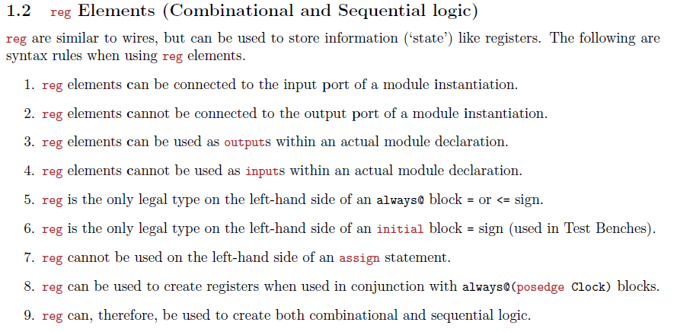

Slide 23
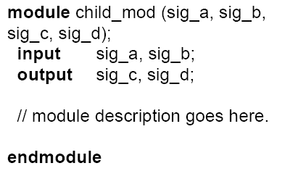
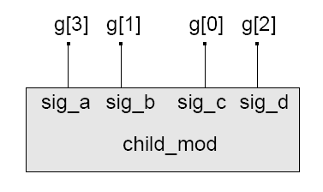
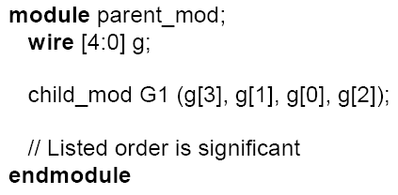
Type of Port Connections for Instantiation
parent_mod
Connection by Position

Slide 24
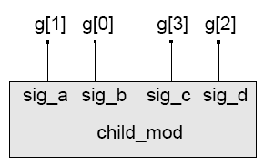
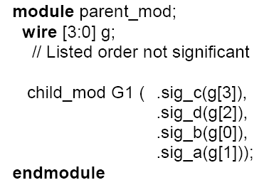
Type of Port Connections for Instantiation
parent_mod
Connection by Name

Slide 25
D-Flip Flop Example
Sensitivity list in the always block
  Event triggered
always @(Clk)
  Sensitive to both 1→0 and 0→1 transitions of Clk
always @(negedge Clk)
  Sensitive to only 1→0 transition of Clk
// D flip flop module
module dff (q, d, clk);
input d, clk;
output q;
reg q;
always @(posedge clk)
// positive edge triggered
begin
q = d;
end
endmodule

Slide 26
Assignments
Blocking assignments (Q = A)
  Variable is assigned immediately
    New value is used by subsequent statements
Non-blocking assignments (Q <= A)
  Variable is assigned after all scheduled statements are executed
    Value to be assigned is computed but saved for later parallel assignment
  Usual use: Register assignment
    Registers simultaneously take new values after the clock edge

Slide 27
Blocking vs. non-blocking
Example: Swap
always @(posedge CLK)
begin
temp = B;
B = A;
A = temp;
end
always @(posedge CLK)
begin
A <= B;
B <= A;
end

Slide 28
Verilog tips
Do not write C-code
  Think hardware, not algorithms
    Verilog is inherently parallel
    Compilers don’t map algorithms to circuits well
Do describe hardware circuits
  First draw a dataflow diagram
  Then start coding

Slide 29
A Flawed Shift Register
This doesn’t work as you’d expect
(= is called blocking assignment, it is sequential):
reg d1, d2, d3, d4;
always @(posedge clk) d2 = d1;
always @(posedge clk) d3 = d2;
always @(posedge clk) d4 = d3;

Slide 30
Non-blocking Assignments
This version does work:
reg d1, d2, d3, d4;
always @(posedge clk) d2 <= d1;
always @(posedge clk) d3 <= d2;
always @(posedge clk) d4 <= d3;
Nonblocking rule:
RHS evaluated when assignment runs
(<= is called non-blocking assignment, it is in parallel):
LHS updated only after all events for the current instant have run

Slide 31
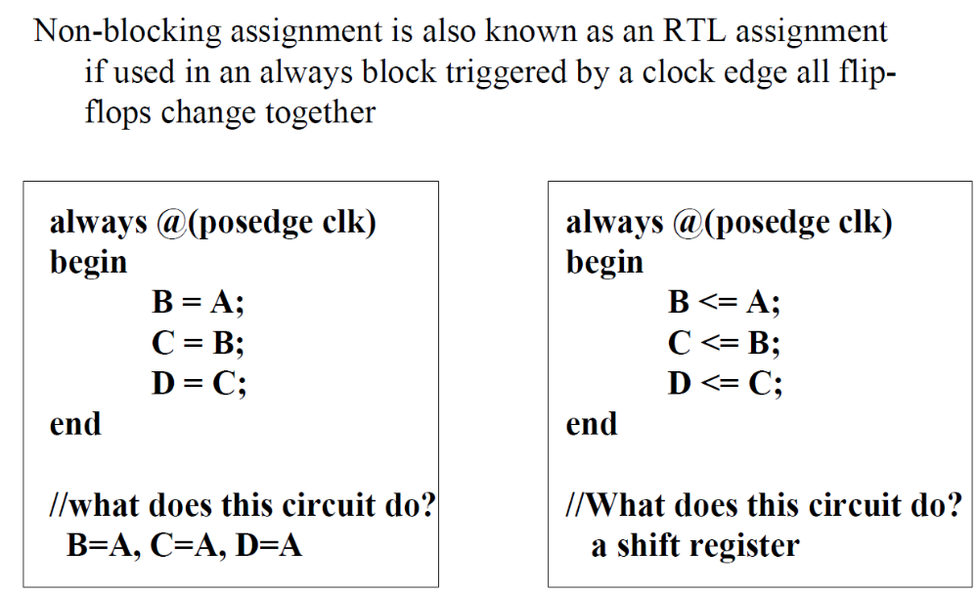

Slide 32
Nonblocking Looks Like Latches
RHS of nonblocking taken from latches
RHS of blocking taken from wires
a = 1;
b = a;
c = b;
a
b
c
1
1
a
a <= 1;
b <= a;
c <= b;
b
c

Slide 33
Numbers are unsigned
C[4:0] = A[3:0] + B[3:0];
  if A = 0110 (6) and B = 1010(–6), then C = 10000 (not 00000)
  B is zero-padded, not sign-extended

Slide 34
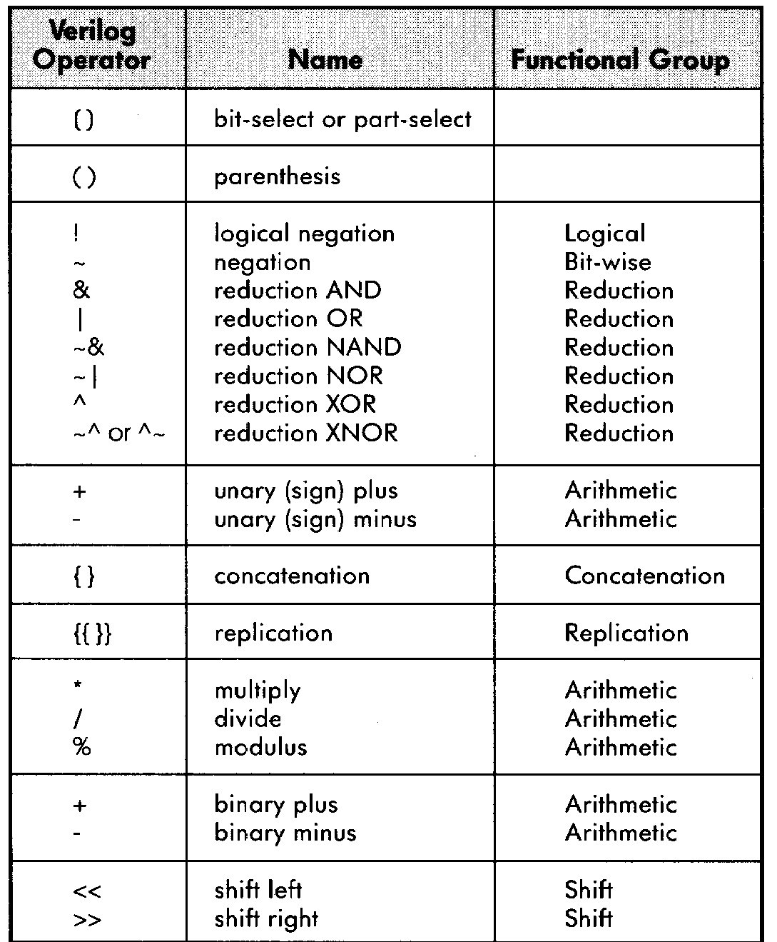
Operators

Slide 35
Testbench
Testbench is a behavioral Verilog code that supplies stimuli to the design under test (DUT) and tests its outputs (“how it behaves”) based on its functional specifications (“how it should behave”).

Slide 36
Inverter Testbench
// testbench module definition
module test_inv;
// stimulus for inverter input
reg inv_inp;
// output of inverter
wire inv_op;
// inverter instantiation
inv u_inv (.inp(inv_inp)), .op(inv_op));
// initial block
initial
begin
inv_inp = 0;
#10 inv_inp = 1;
#10 inv_inp = 0;
// inv_op will be driven by u_inv
#10 $finish; // end simulation
end
endmodule

Slide 37
Example
module block_nonblock();
reg a, b, c, d , e, f ;
// Blocking assignments
initial begin
a = #10 1'b1;// The simulator assigns 1 to a at time 10
b = #20 1'b0;// The simulator assigns 0 to b at time 30
c = #40 1'b1;// The simulator assigns 1 to c at time 70
end
// Nonblocking assignments
initial begin
d <= #10 1'b1;// The simulator assigns 1 to d at time 10
e <= #20 1'b0;// The simulator assigns 0 to e at time 20
f <= #40 1'b1;// The simulator assigns 1 to f at time 40
end
endmodule

Slide 38
4-bit ALU - Structural
Components needed (for one of the design options)
4-bit inverter
  inverter
4-bit ripple carry adder
  full adder
4-bit multiplexer
  can be constructed out of 2-to-1 multiplexers
Note: for internal wire definitions, use the keyword “wire”

Slide 39
4-bit ALU - Behavioral
Algorithmic description using functional operators in Verilog:
case (mode)
0 : out = bitwise invert of A
1 : out = A + B
2 : out = A - B
3 : out = 2*A
endcase

